Slide 1
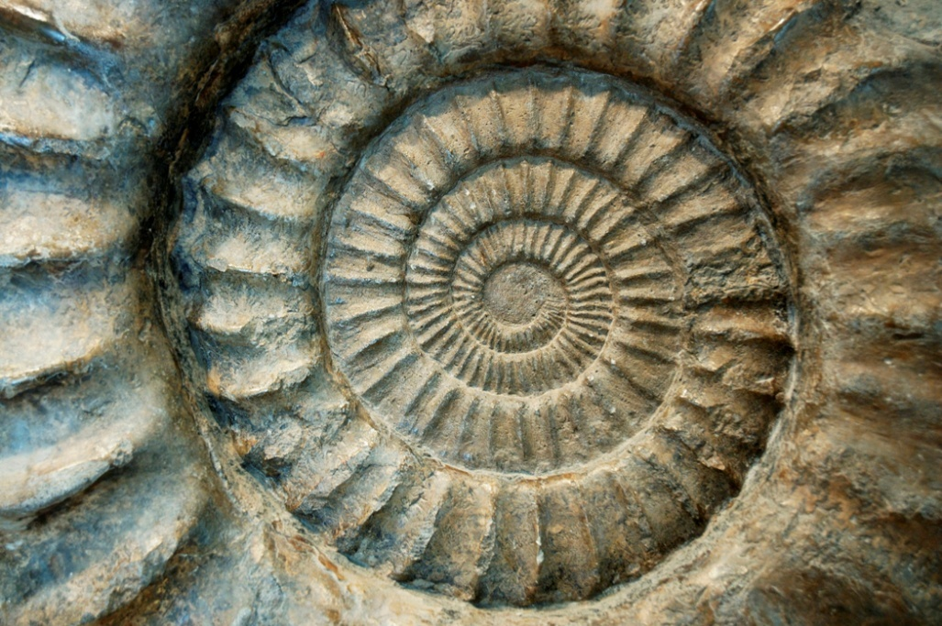
Fossils and The Law of Superposition

Slide 2
Fossils and Superposition
What is a fossil?
The trace or remains of an organism that lived long ago, most commonly preserved in sedimentary rock
What is a superposition?
Younger rocks lie above older rocks if the layers have not been disturbed

Slide 3
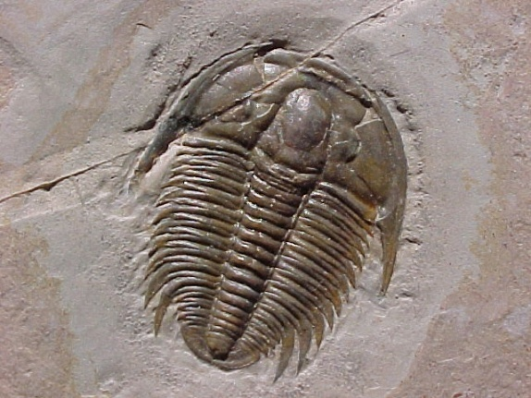
Relative Dating and Index Fossils
What is relative dating?
Any method of determining whether an event or object is older or younger than other events or objects.
What is an index fossil?
A fossil that is found in the rock layers of only one geologic age and is used to establish the age of the rock layers.
Is found in rock layers
around the world, ex Trilobites

Slide 4
Activity # 1
On your desk, you have 8 large colored index cards with nonsense letters placed on them.
Your task is to determine what the correct sequence of the letters are.
You have two clues:
The card with the letters “C” and “T” is on the bottom, or the oldest layer
Look for a card that has either a “T” or “C” written on it for the second layer

Slide 5
M
D
X
O
N
B
U
A
G
C
T
This is one possible way to arrange the cards.
Questions:
What letter is the oldest?
What letter is the youngest?
What letter showed up the most?
Which letters only showed up once?
Which letters could be index fossils?
How did you know which was older: “M” or “X”?
MD
DXO
ON
NB
NBU
UA
AGC
C T

Slide 6
Activity # 2
Flip your eight index cards over
Arrange the index cards that represent layers of rock and fossils
Clues:
The oldest layer has the letter “M” in it
Find a rock layer that has at least one of the fossils you found in the oldest rock layer
Extinction is forever - once an organism disappears from the sequence it cannot reappear later

Slide 7
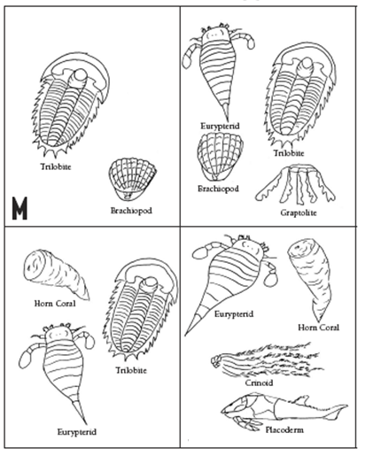
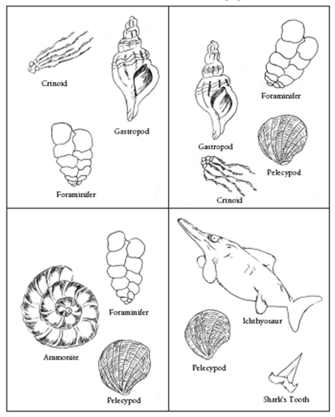
Teacher Note: I replaced the letters with nonsense letters b/c spelling the word “organism” was too easy for my 5th graders

Slide 8
To think about…
What problems did you run into when trying to arrange the fossils into the correct sequence?
Would this have been more difficult if you did not know which layer was the oldest to start the activity?
Which organism is the most complex of all the fossils and why?

