Slide 1
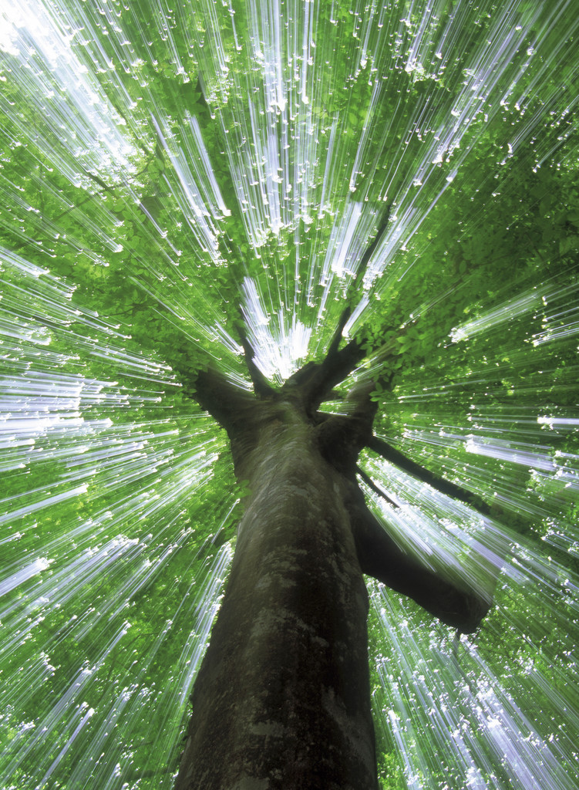
Lifecycle of a Tree

Slide 2
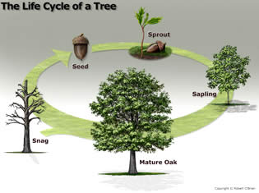
Lifecycle of Trees
It is important that students understand the biology of trees to further be aware of trees’ role in the ecosystem throughout its life.
Seedling
Seed
Sapling
Snag
Mature Oak
How to Measure & ID
Week 1 Day 3

Slide 3
Background
Like all living things trees have a life cycle:
Birth
Growth
Aging
Death
As trees grow, their physical form changes as does their role in the forest ecosystem

Slide 4
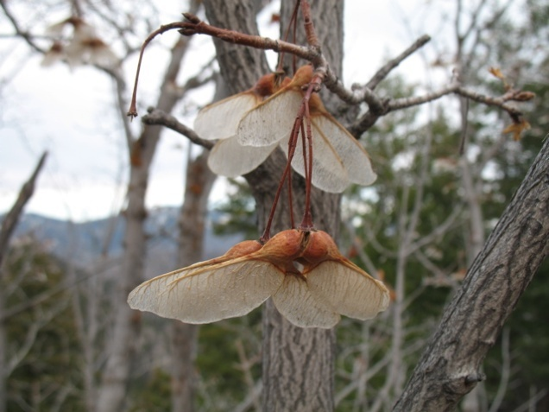
Seeds
Which came first - the tree, or the seed?
Seeds come in a variety of shapes,
weights, colors, and sizes, depending on the species.
Seeds develop from male and female parts of the trees producing fruits.
Some seeds are in a protective nut like an acorn
Others are in fleshy fruits, like the black cherry.
The fruit of a pine is a cone and the seed is winged and resembles a miniature helicopter when falling.
Wind, water, animals, and people disperse seeds to the forest floor, open fields, yards and roadsides.
Where conditions are favorable for germination, seeds will germinate and grow.

Slide 5
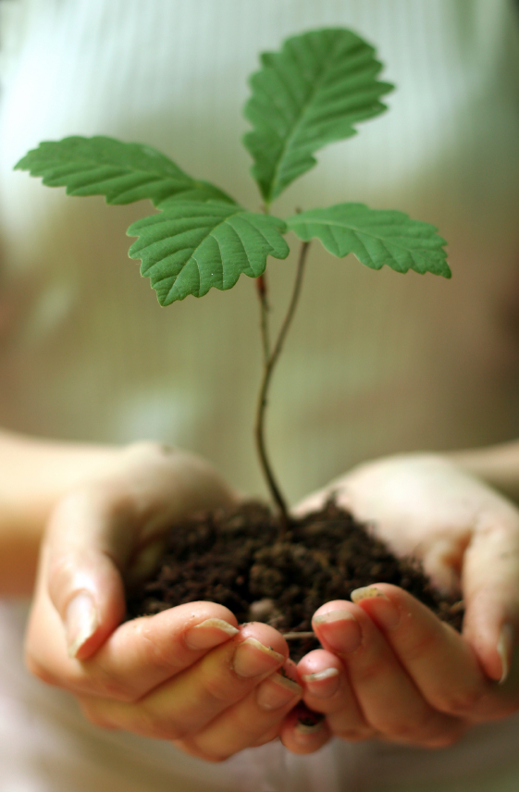
Seedling
The seedling grows and begins to develop woody characteristics.
The stems harden, change color, and develop a thin protective bark.
The stem may bend or develop branches that reach toward light.
Leaves or needles that develop are adapted to shade, but lean or tilt toward light.
Most roots are in the upper soil to absorb water, nutrients and air.
Seedlings compete for nutrients, water, sunlight, and space.
Threats include fire, flood, drought, disease, insect attacks, and animals.
At this stage the tree is most susceptible to being killed.

Slide 6
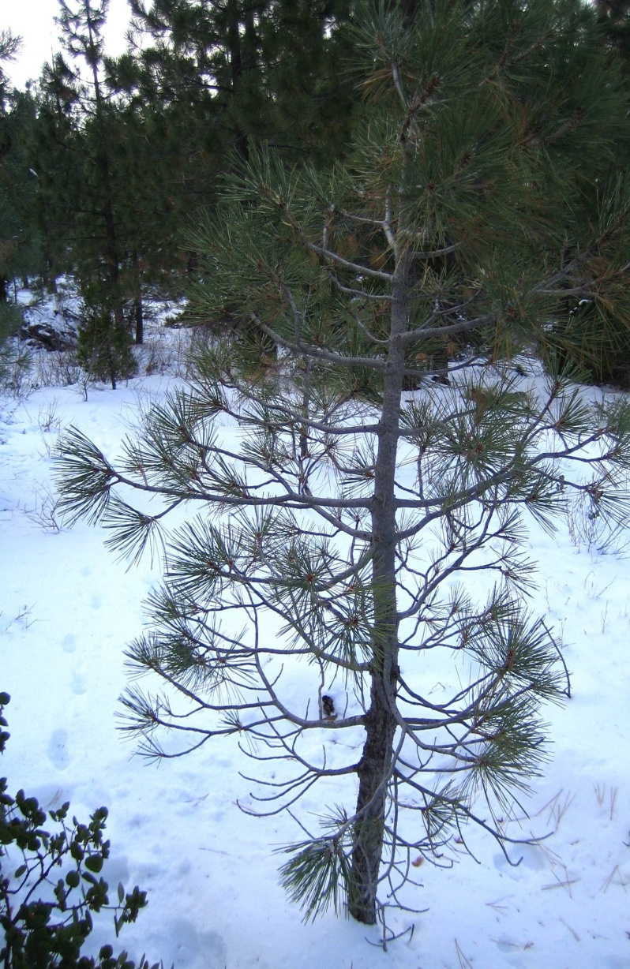
Sapling
When the tree is about 1-4 inches in diameter at 4.5 feet, it is considered a sapling.
standard height where tree’s diameter is measured – diameter at breast height (DBH).
As the tree starts to get taller the trunk thickens and branches develop.
A sapling is the size of a tree growing in a nursery.
In this juvenile state, the tree is not mature enough to reproduce.
Growing rapidly, the sapling has the same competition and threats as seedlings.

Slide 7
Mature
What does DBH mean?
With favorable conditions, a sapling will grow into a mature tree (>4 inches DBH).
During this stage, each tree will grow as much as its species and site conditions will permit.
In addition, flowers develop, reproduction ensues, fruits form, and seed dispersal can now occur.
Trees provide the maximum environmental benefits to people during this stage.

Slide 8
What plant in the picture would you say is a mature tree?

Slide 9
Decline
The life span of a tree is a wide-range, yet death is inevitable.
A combination of factors overcome a tree and causes it to die.
Injury, drought stress, followed by disease, rot, root dieback, coupled with a lightning strike or insect infestation contribute to tree decline.
Sometimes a single factor is serious enough to cause mortality.

Slide 10
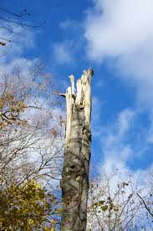
Dead Tree
Standing dead trees, called snags, play vital roles in the life cycle of many organisms.
A snag slowly breaks down and returns nutrients as limbs, bark, and branches fall. It provides habitat and food for wildlife and insects.
Animals, insects, and fungi help break down the tree.
Eventually, the snag will fall and return nutrients to the soil where they are taken up by other trees.
And, the cycle begins anew.

Slide 11
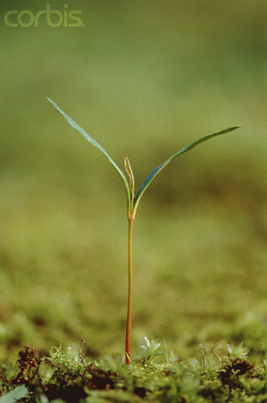
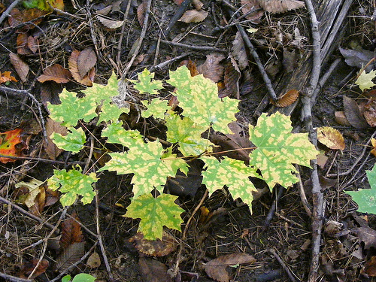
What stage of the lifecycle are these trees in currently?
SEEDLING ☺

Slide 12
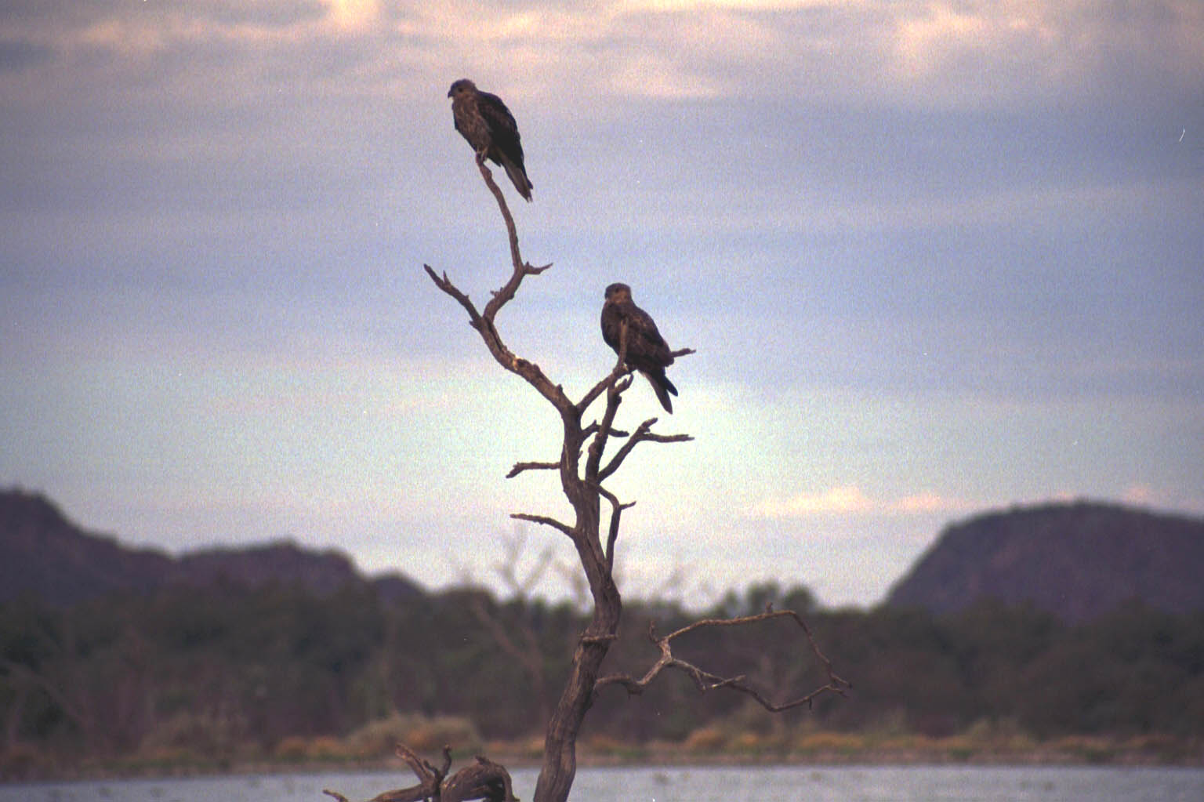
What stage of the lifecycle are these trees in currently?
SNAG ☺

Slide 13
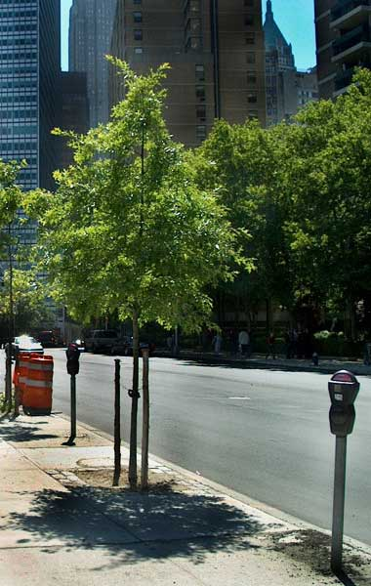
What stage of the lifecycle are these trees in currently?
SAPLING ☺

