Slide 1
OUR ATMOSPHERE

Slide 2
ATMOSPERE
A mixture of gases surrounding a planet or moon.

Slide 3
Atmospheric Gases
Nitrogen (N) 78%
Oxygen (O) 21%
Water Vapor (H₂0) 0.0 – 4.0%
Trace gases & Debris 1%

Slide 4
Trace Gases
Neon – emits a glowing light
Helium – lighter than air
Methane – natural gas
Krypton – hidden gas
Xenon – strobe light
Hydrogen – organic
Ozone – protects / pollutes

Slide 5
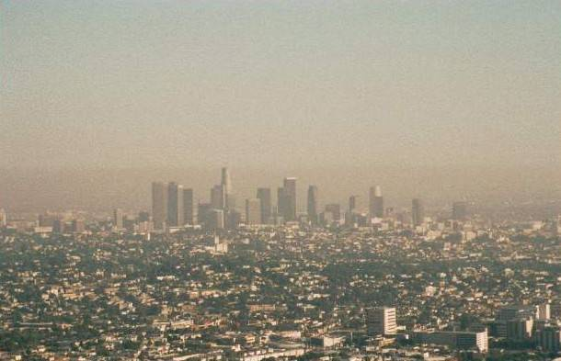
SMOG
A hazy condition in the atmosphere created when a variety of pollutants mix and then react with sunlight.

Slide 6
Describe 3 physical states of water:
Solid (Snow / Sleet)
Liquid (Rain)
Gas (Cloud, fog, smog)

Slide 7
How does the atmosphere stay around the Earth w/out going into space?
GRAVITY

Slide 8
Air Pressure
The measure of the force w/ which air molecules push on a surface.
Closer to Earth, air is more dense causing more pressure.

Slide 9
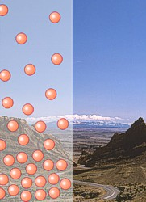
This is an illustration showing how air pressure is greater near the Earth’s surface. Notice that there are more air molecule in the lower elevation. Air molecules spread out as they rise, because there is less pressure, therefore, there are fewer air molecules on top of a mountain than at the base of the mountain.

Slide 10
Name the Layers of the Atmosphere
Troposphere
Stratosphere
Mesosphere
Thermosphere
Exosphere

Slide 11
Troposphere
From the ground to 12 km
75% of the atmospheric gases
90% of the atmosphere’s total mass. (densest layer)
The part we live in.

Slide 12
Stratosphere
31 miles above the Earth's surface
Ozone layer
Protects life on Earth by absorbing UV rays.
Gases are layered and do not mix.

Slide 13
Ozone
A gas that occurs naturally in the stratosphere, that protects the earth from the sun’s radiation.
When formed in the air above cities, it is a pollutant that can harm plants and damage our lungs.

Slide 14
Mesosphere
53 miles above earth
Middle layer
Very cold
meteorites

Slide 15
Thermosphere
430 miles above earth
Temperature can reach 3,600°F (very hot)
Feels cold due to low air content.
Ionosphere – reflects radio waves.

Slide 16
Ionosphere
A layer of electrically charged particles that allows radio waves to be reflected which allows for transmission and reception of radio signals.

Slide 17
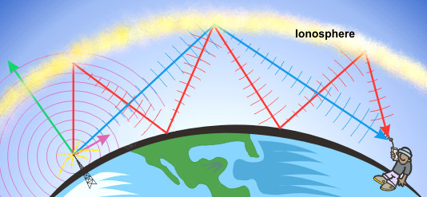

Slide 18
Exosphere
6200 miles above earth
Outer layer
Satellites orbit the earth.
Space

Slide 20
Temperature and Air Pressure
Higher Temperature = Lower pressure.
Reason: heated air molecules move w/ greater energy causing the molecules to become less dense in an area.
Lower Temperature = Higher pressure.
Reason: cool air molecules slow down and become more dense causing the volume of air to weigh more.

Slide 21
Why does the troposphere, in which we live, feel hotter than the thermosphere when the tempº of the thermosphere reaches over 1,000º?
Air molecules are closer together, therefore, colliding and transferring thermal energy.

Slide 22
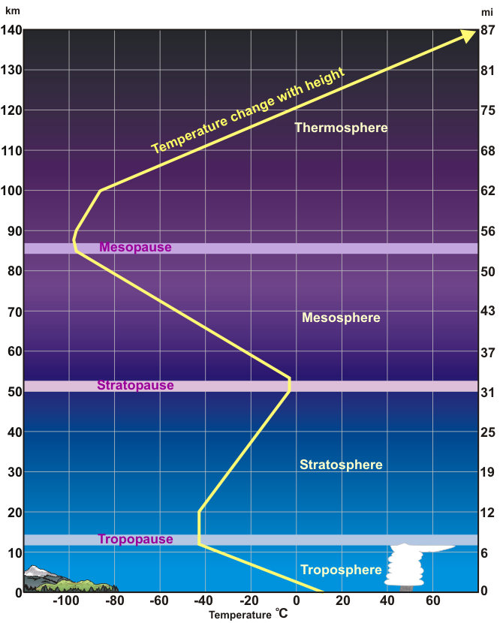

Slide 23
How do you measure air pressure in the atmosphere?
Barometer

Slide 24
How to read a barometer:
High air pressure
Low moisture
Cooler temperature
More air molecules
Low air pressure
Moist, saturated air
Warmer conditions
Less air molecules and more water molecules.

Slide 25
